Slide 1
3D Transformation
Course Code: CSC 3224
Course Title: Computer Graphics
Dept. of Computer Science
Faculty of Science and Technology
Lecturer No: | 8 | Week No: | 07 | Semester: | Fall 2021-2022
Lecturer: | MAHFUJUR RAHMAN, mahfuj@aiub.edu

Slide 2
Transformations

Slide 3
3D Axis

Slide 4
3D Transformations

Slide 5
3D Translation

Slide 6
3D Scaling

Slide 7
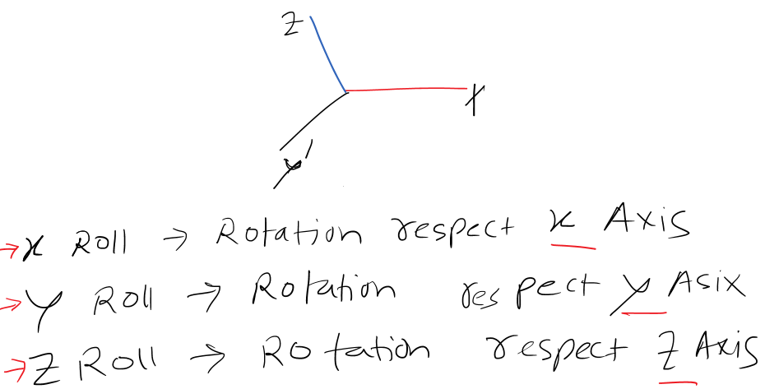
3D Rotation

Slide 8
3D Rotation

Slide 9
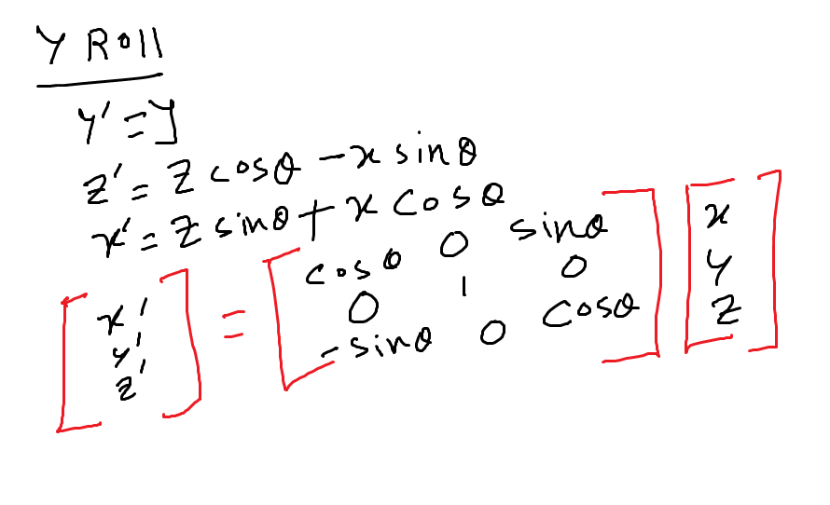

Slide 10
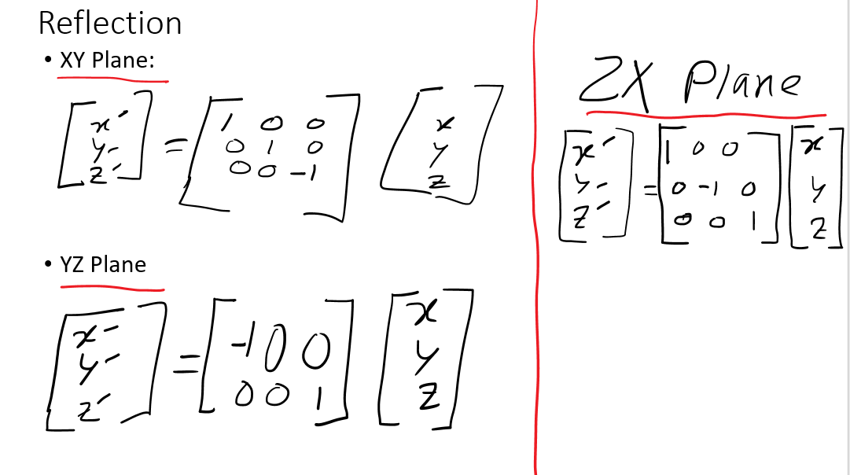
3D Scaling

Slide 11
Books
Foley, van Dam, Feiner, Hughes, Computer Graphics: principles and practice, Addison Wesley, Second Edition.
Schaum's Outline of Theory & Problems of Computer Graphics.
Peter Shirley Steve Marschner , “Fundamental of computer graphics”, Third Edition.

Slide 12
References
https://www.gatevidyalay.com/3d-translation-in-computer-graphics-definition-examples/
https://en.wikipedia.org/wiki/Transformation_matrix
https://www.javatpoint.com/computer-graphics-3d-transformations
https://www.slideshare.net/DelwarHossain8/3d-transformation-computer-graphics
https://en.ppt-online.org/31501
https://www.slideserve.com/thomas-kirby/2d-and-3d-transformation-powerpoint-ppt-presentation
https://slideplayer.com/slide/5061630/

